Slide 1
QF602: Derivatives
Lecture 1:
Introduction to Derivatives

Slide 2
What are Derivatives?
Financial instrument that “derives” cash ﬂows from price of some other asset.
Typically, an agreement between two parties to exchange cash flows.
Derivatives can be used to hedge against unfavorable price changes, or speculate on favorable price changes.
Hedging means mitigate or reduce risks.

Slide 3
Types of Underlying Assets
Physical assets such as agricultural products, precious metals, or fossil fuels.
Financial assets such as stocks or bonds (or even other derivatives!).
Intangible assets such as electricity or weather.
Derivatives can also be written on an FX rate, or an interest rate.

Slide 4
Types of Derivatives
Some Derivatives represent obligations. Both parties are required to follow through on transactions, irrespective of gain or loss.
Other Derivatives represent options. One party has the right but not the obligation to buy or sell an asset. The other party receives a fee to sell that right.

Slide 5
Where can we trade them?
Some Derivatives are traded on an exchange, such as Chicago Mercantile Exchange (CME).
Exchange-traded Derivatives feature standardized terms and conditions, high liquidity, and price transparency.
Clearing house operated by exchange serves as “central counterparty” to ensure that all transactions are completed.

Slide 6














Derivatives Exchanges
Interest Rates and Bond Derivatives, Commodities, Equity Index Derivatives, Stock Options and Stock Futures and ETF Options
Derivative product linked to Agriculture, Energy, Equity Index, FX, Interest Rate and Metals
Futures & Options based on Agriculture, Index, FX, Oil & Gas, Electricity
Index Futures, JGB (Japan Government Bond) Futures and Options on JSG Futures, TOPIX (Tokyo stock Price Index) Options, Individual Options
Index Futures, Index Options, Security Options, OSE-FX (OSAKA Securities Exchange-FX)
Derivative based on Interest Rate, Equity, Equity Index, Dividend, Volatility Index, Inﬂation, Commodity, Weather and Property
Equity Index Futures & Options, Stock Futures & Options, Currency Futures, Interest Rate and Fixed Income Futures, Gold Futures
Interest Rate Futures & Options, Equity Index Futures & Options, Dividend Index Futures, Derivatives linked to Agriculture, Energy and Metal, FX Forward, Interest Rate Swaps
Futures and Options linked to Equities, Interest Rates, Agriculture, Energy and Environmental Markets. CFDs for Equities, Indices and Commodities.

Slide 7
Types of Derivatives
Other Derivatives, known as “over-the-counter” (OTC) Derivatives, are direct bilateral agreements with no central counterparty.
Generally, one party will be major ﬁnancial institution acting as “market maker”.
OTC Derivatives have more ﬂexibility for terms and conditions, but less price transparency and no protection from credit risk.

Slide 8
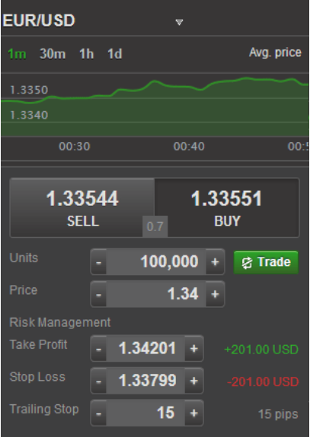
Market Making
If you want to long 100k EURUSD, what would you do?
You find an FX broker, open and account, put some money into the account and then trade.
Most of them will have a mobile app looks like below

Slide 9
Market Making
Some FX lingos
1.3354, the 3 in the middle is called the big figure/handle.
1.3354, the 4th digit after the dot is called one pip.
100 pips = 1 big figure
The last digit is 1/10 of a pip.

Slide 10
Market Making
If you want to buy 100K EURUSD now, the price is 1.33551.
But if you want to sell 100K EURUSD now, the price is 1.33544.
Note that if you buy and sell simultaneously then you will guarantee to lose
100k * (1.33544-1.33551) = $7
Who earns that $7? Market makers.
The $7 is the bid-offer spread.

Slide 11
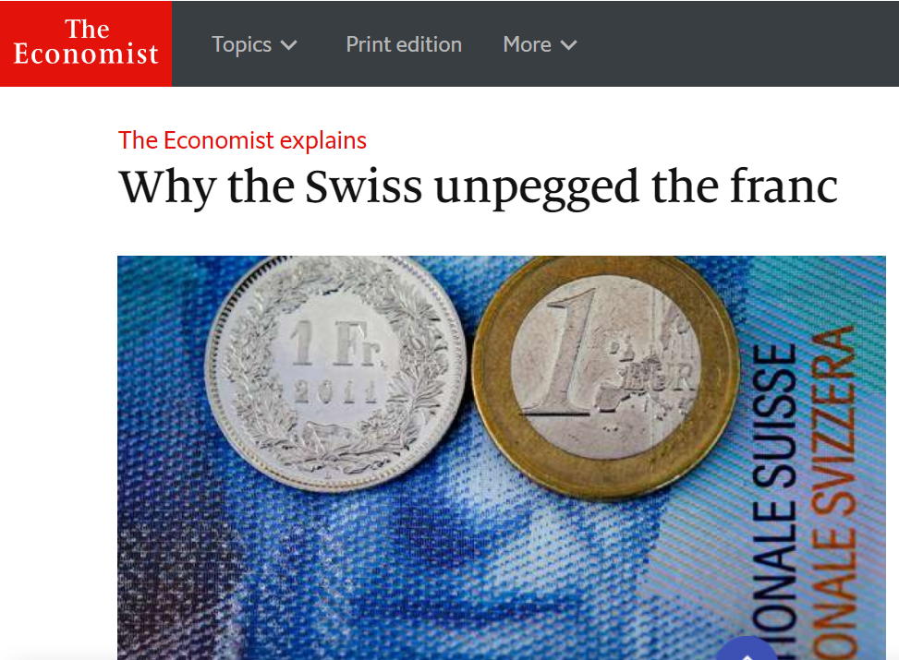
Market Making
Market makers are there to provide the liquidity to trade even in extreme market conditions, like the SNB unpegged CHF against EUR on 15 Jan 2015.
On return, they charge a spread to provide that service.

Slide 12
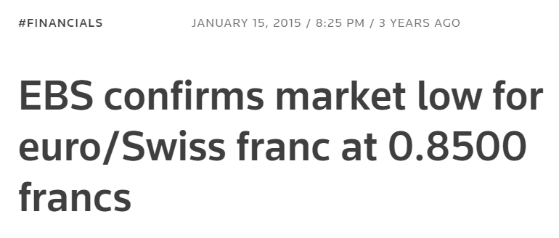
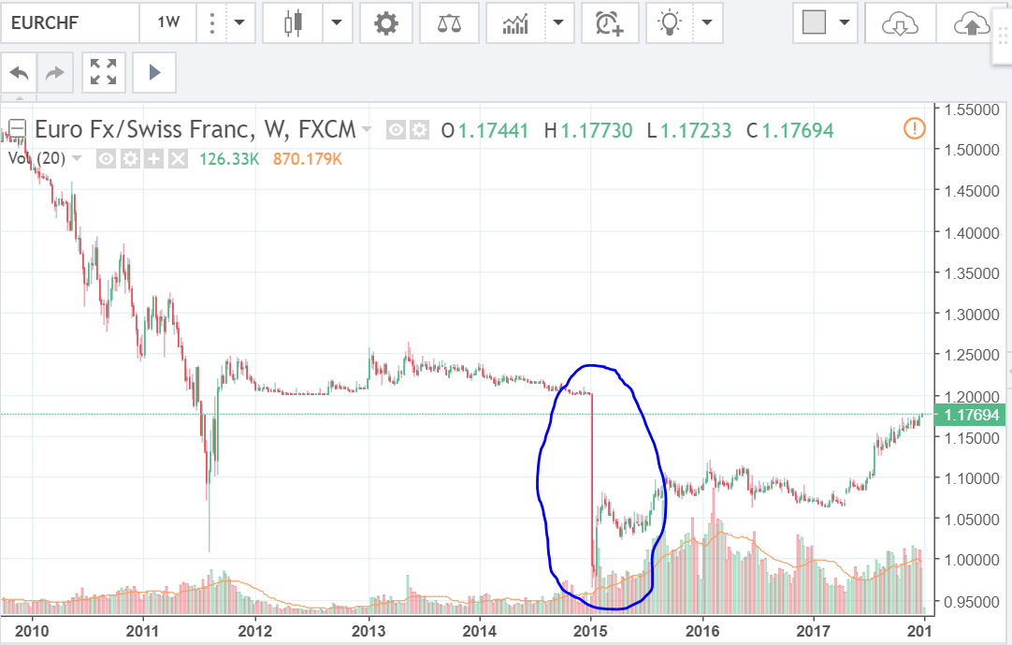
Market Making
EURCHF dropped to 0.85 from 1.2 in a matter of minutes.

Slide 13
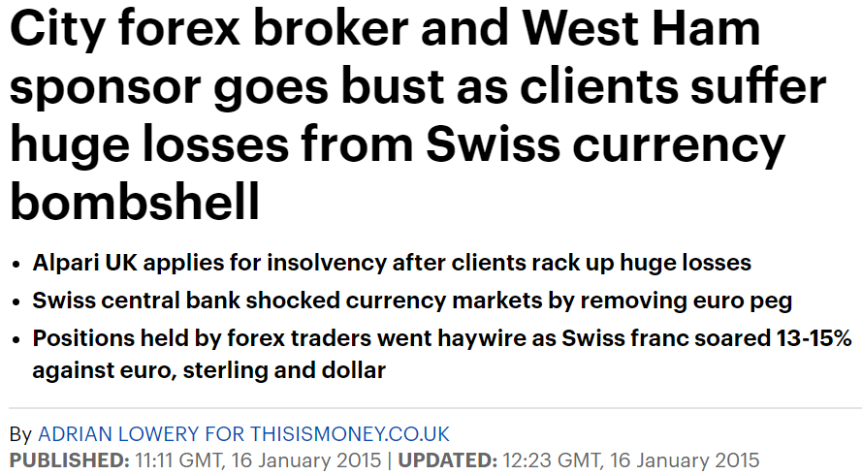
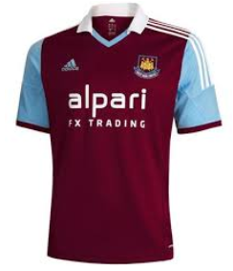
Market Making
A few brokers went bust because of that event.

Slide 14
Types of Derivatives
Forward contract is an OTC derivative that represents obligation.
Futures contract is an exchange-traded derivative that represents obligation.
Option contract is an OTC or exchange-traded derivative that represents option.
Forward rate agreement (FRA) is forward contract on (short-term) interest rate.
Interest rate swap (IRS) is sequence of FRAs.

Slide 15
Credit Risk
Credit risk is a risk that counterparty will default on terms of agreement.
If derivative represents obligations, then both parties will be exposed to credit risk (since either party could potentially incur loss).
If derivative is an option, in general, only the party with the right (long the option) will be exposed to credit risk.

Slide 16
Credit Risk
For OTC Derivatives, both parties are exposed to credit risk, although market maker is unlikely to default.
In some cases, market maker might demand collateral or impose central counterparty.
For exchange-traded Derivatives, central counterparty bears all credit risk while customers receive almost complete protection.

Slide 17









Exchange-Traded vs OTC
BUYER EXCHANGE
SELLER
Central counterparty eliminates credit (default) risk
Standardized products and pricing transparency
Both parties subject to credit (default) risk
Flexible products but pricing opacity

Slide 18
Time Value of Money
$100 to be paid 1 year from now (Future Value)
5% interest rate per annum, denote as r.
Present value (PV) can be computed as
PV = Future Value * Discount Factor.
DF(T) = exp(-r*T) = 0.9512, where T=1, r=5%.
We assume continuous compounding in this course unless otherwise stated.

Slide 19
Forward contract
A forward contract is an agreement between 2 parties to buy or sell an asset at maturity.
No cash flows until maturity.
The price agreed to buy or sell the asset at maturity is call the strike price, K.
The value of the forward contract V at t is computed as:
V(t) = (F(t,T) – K) * DF(T-t).
Forward contract to have 0 value at inception has strike price equals to the forward price at time 0, i.e. V(0) = 0, if
F(0,T) = K.

Slide 20
Forward price
S(t) denotes the price of a stock at time t.
F(t,T) denotes the forward price at time t with maturity T, t<=T.
Consider a stock that pays no dividends and is worth $50, S(0) = $50.
6 month interest rate is 6% per annum, r = 6%.
Forward price of a stock can be viewed as equal to the spot price plus the cost of carrying it.
The cost of carry is equal to the interest that might be received if he had immediately sold the stock and invested in a risk-free investment.

Slide 21
Forward price
Forward price can be computed as:
F(t,T) = S(t) * exp(r*(T-t)) = S(t) / DF(T-t)
To compute a 6 month forward price, we can set t=0, T=6/12 and we get
F(0, 6/12) = $50 * exp(6% * 6/12) = $51.52.

Slide 22
Forward price
So what if the stock provides an additional income to the stockholder?
Stock pays dividend and one can also lend out the stock to earn an extra income via repurchasing agreement, aka repo.
The cost of carry decreases.
Dividend yield = 1% p.a., repo rate = 2% p.a. for 6 month period.
The 6 month forward price now becomes
$50 *exp( (6%-1%-2%)* 6/12) = 50.76.

Slide 23
Payoﬀ Diagram of Long Forward
V(T)
K
45º
0
Price of Underlying Asset at Maturity F(T,T) = S(T)

Slide 24
Payoﬀ Diagram of Short Forward
V(T)
K
45º
0
Price of Underlying Asset at Maturity F(T,T) = S(T)

Slide 25
Futures contract
A futures contract is an exchange-traded contract in which the holder has the obligation to buy/sell an asset on a future date at a market-determined price called the futures price.
The contract specifications like quantity, time and place of delivery are determined by the exchange.
The assets can be a commodity, a stock, an index, etc…
Futures is considered safer than forward since the counterparty risk is almost totally eliminated.

Slide 26
Futures contract
Futures contract are marked-to-market (mtm) on a daily basis.
Every buyer/seller must maintain a certain amount with an account at the exchange.
If the price movement is against you, the balance of your account reduces. If it drops below the maintenance margin then you will need to top up to the initial margin.

Slide 27
Futures vs Forward
FUTURES | FORWARD
Traded at Exchange | OTC
Standardized Contract Size, Minimum Price Change (1 Ack ), Fixed Maturity Dates each year, and Fixed SeFlement Terms | Customized
No Counter-Party Risk, Guarantee by Exchange. Exchange via a clearing member is de facto counter-party to both buyer and the seller | Counter-Party Risk
Fixed Trading Hours | No Fixed Trading Hours
Daily Price Limits may exist | No Daily Price Limits
Usually many contracts of diﬀerent maturiAes are traded simultaneously | Not Applicable
Almost conAnuous mulAple trader market-making in open outcry or electronic communicaAons/trading network oﬀers liquidity and ease to close out posiAons | Usually inter-bank or principal-to-principal price quotaAons. Market is less liquid.
Typically lower transacAon costs due to standardizaAon and trade volumes | High transacAon costs
Contract is marked to market (revalued and seFled) daily | Contract is not marked to market daily
Both long or short posiAons require posAng of a margin (or collateral) in a margin account. The margin is revised conAnually. | In general there is no margin requirement
Any minor trade dispute between buyer or seller can be seFled quickly at the Exchange | Trade dispute can be quite troublesome

Slide 28
Example: Mark-to-Market
Futures price: $100
Initial margin: $7 per contract Maintenance margin: $4 per contract
Investor A buys 500 contracts, while investor B sells (shorts) 500 contracts
Initial margin: 500 × $7 = $3,500 Maintenance margin: 500 × $4 = $2,000

Slide 29
Example: Mark-to-Market
Trading Day | Settlement Price
1 | $99
2 | $97
3 | $98
4 | $95
Settlement price is (average) closing price used for mark-to-market

Slide 30
Example: Mark-to-Market
Investor A’s Margin Account
Day 1:
P/L = ($99 – $100) × 500 = −$1 × 500 = −$500
Balance = $3500 – $500 = $3000
Price is marked-to- market at $99 and margin account is debited accordingly
Day 2:
P/L = ($97 – $99) × 500 = −$2 × 500 = −$1000
Balance = $3000 – $1000 = $2000
Day 3:
P/L = ($98 – $97) × 500 = +$1 × 500 = +$500
Balance = $2000 + $500 = $2500
Day 4:
P/L = ($95 – $98) × 500 = −$3 × 500 = −$1500
Balance = $2500 − $1500 = $1000 Receive margin call to deposit $2500 to bring balance up to initial margin
Variation margin

Slide 31
Example: Mark-to-Market
Investor B’s Margin Account
Day 1:
P/L = ($100 – $99) × 500 = +$1 × 500 = +$500
Balance = $3500 + $500 = $4000 Withdraw $500 to bring balance to $3500
Day 2:
P/L = ($99 – $97 ) × 500 = +$2 × 500 = +$1000
Balance = $3500 + $1000 = $4500 Withdraw $1000 to bring balance to $3500
Day 3:
P/L = ($97 – $98 ) × 500 = −$1 × 500 = −$500
Balance = $3500 − $500 = $3000
Day 4:
P/L = ($98 – $95 ) × 500 = +$3 × 500 = +$1500
Balance = $3000 + $1500 = $4500 Withdraw $1000 to bring balance to $3500

Slide 32
Futures Price vs Forward Price
Futures price may be diﬀerent from forward price when margin account earns interest
If risk-free interest rate is constant, then futures price will be same as forward price

Slide 33
Futures Price vs Forward Price
If risk-free interest tends to move in same direction as futures price (i.e. positively correlated), then long party tends to beneﬁt at expense of short party.
To compensate, futures price will be higher than corresponding forward price

Slide 34
Futures Price vs Forward Price
Conversely, if risk-free interest tends to move in opposite direction as futures price (i.e., negatively correlated), then short party tends to beneﬁt at expense of long party
To compensate, futures price will be lower than corresponding forward price

